Slide 1

SSP Course Project Mid Submission
End Of Phrase Detection
MENTOR: PROF. ANIL KUMAR VUPPALA
TEAM
Srihari Bandarupalli : 2021112006
Jalluri Ram Gopal: 2021102013
Monsoon 2023
1
October 31st, 2023

Slide 2
R
S
Agenda
i) | INTRODUCTION | 3
ii) | KEY CHALLANGES | 4
iii) | METHODS AND APPROACHES | 5
iv) | HINDI EXAMPLE | 6
v) | RESULTS ON HINDI EXAMPLE | 7
vi) | TELUGU EXAMPLE | 8
vii) | FURTHER PLAN | 9
viii) | REFERENCES | 10
Monsoon 2023
2
October 31st, 2023

Slide 3
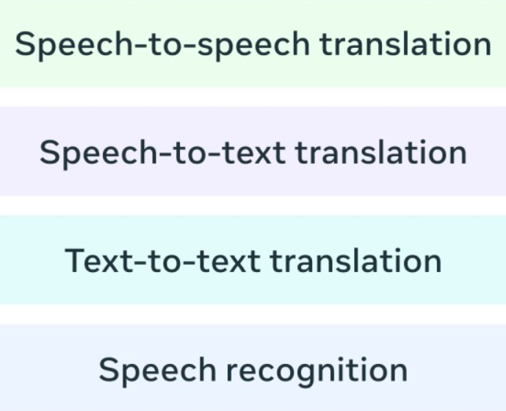
i) Introduction
Introduction
While humans naturally recognize pauses, punctuation, and intonation in a natural spoken language, computers need assistance
In Speech to text Translation we loose all the punctuation and context which can be preserved by detecting the phrase endings
Monsoon 2023
3
October 31st, 2023

Slide 4




ii) Key Challanges
R
S
Key Challanges
Identifying silences in speech as potential phrase endings is a fundamental approach of End of Phrase Detection.
But it is important to note that not all silences indicate the end of a phrase. They could be pauses for commas or full stops.
For this differentiation, a deeper analysis of pitch contour trends is necessary.
Monsoon 2023
4
October 31st, 2023

Slide 5
iii) Methods and Approaches
Methods and Approaches
Extracting information from pitch in speech is a complex process due to its noise.
To simplify pitch contours, we employ the prosogram, which identifies nuclei of salient pitch areas and categorizes them into Low,Mid or High labels
We try to develop rules to predict clause and sentence boundaries based on the changing trend of these pitch labels.
Monsoon 2023
5
October 31st, 2023

Slide 6
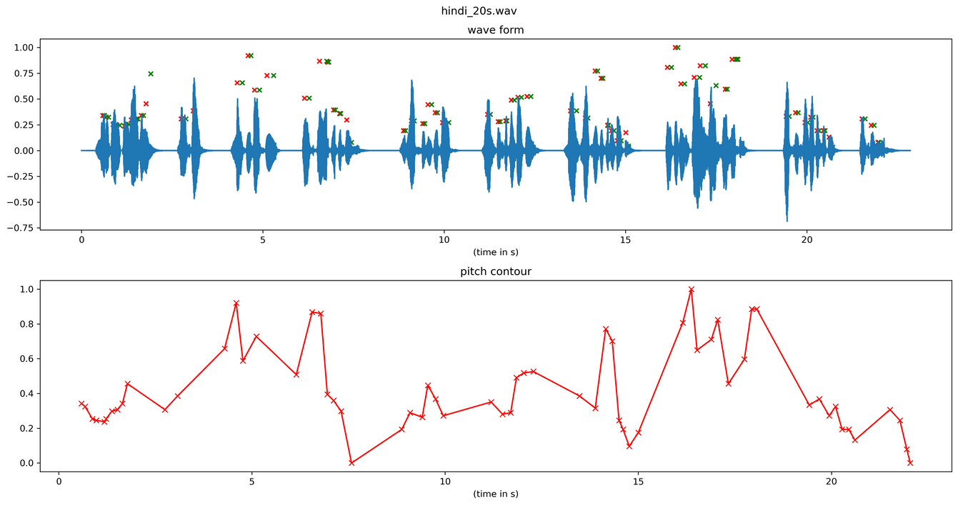
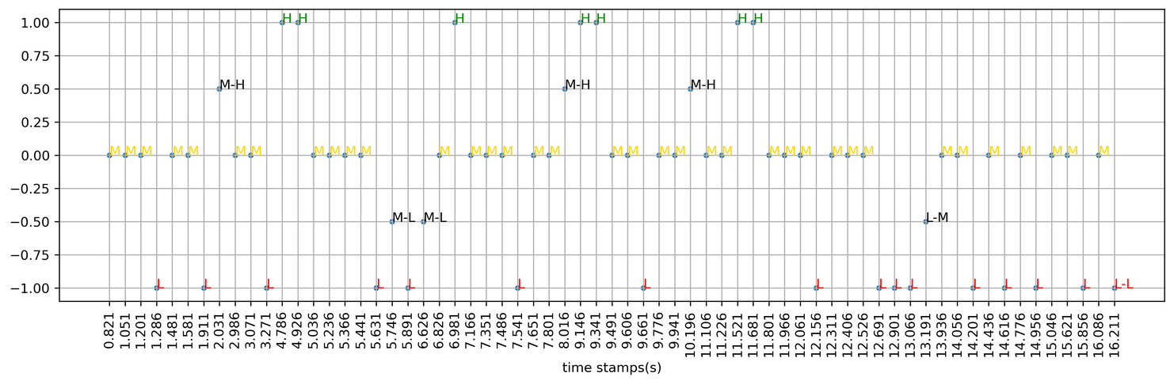
iv) Hindi Example
Hindi Example (20 s)
Pitch Contour
Prosogram
We have quantized the Pitch Contour into H,M and L to create a Prosogram
Monsoon 2023
6
October 31st, 2023

Slide 7
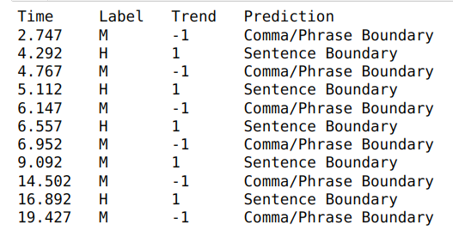
v) Results On Hindi Example
Observed Trends
L -> M -> _L : Comma
L -> H -> _M/L : Comma
M -> H -> _M/L : Comma
M -> L -> _M/H : Sentence Boundary
H -> M -> _H : Sentence Boundary
H -> L -> _M/H : Sentence Boundary
Observed Trend
A rising tone for commas and a falling tone for sentence boundaries.
Monsoon 2023
7
October 31st, 2023

Slide 8
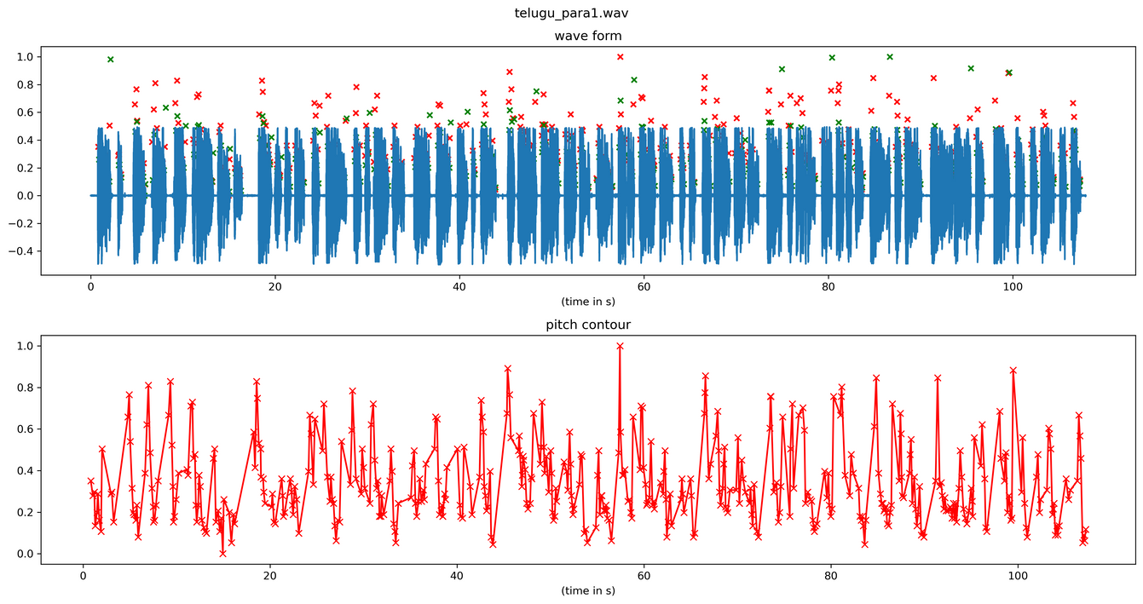
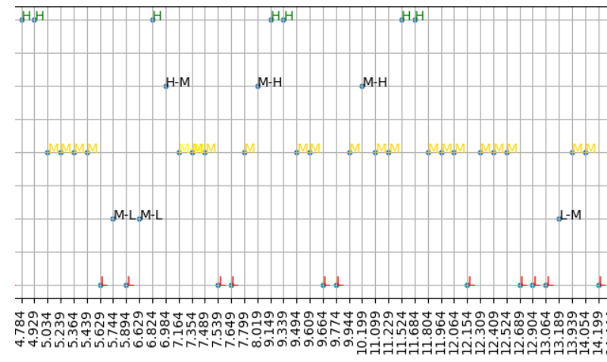
vi) Telugu Example
Telugu Example (15 s)
Pitch Contour
Prosogram
We have quantized the Pitch Contour into H,M and L to create a Prosogram
Monsoon 2023
8
October 31st, 2023

Slide 9
vii) Further Plan
Further Plan
Refining Prosogram Analysis:
We propose a focused approach: consider trends near silence regions for punctuation identification as all rises and falls in the prosogram are not associated with punctuations.
Extending Analysis to Emotional Speech:
We aim to apply a similar analysis to emotional speech and explore how emotional cues affect phrase boundaries and punctuation patterns.
Monsoon 2023
9
October 31st, 2023

Slide 10
viii) References
References
Tanmai Khanna, Ganesh Mirishkar, Dipti M. Sharma, Anil K. Vuppala. Exploring the role of pitch in predicting clause and sentence boundaries. R & D Showcase 2020.
Monsoon 2023
10
October 31st, 2023

Slide 11
THANK YOU
TEAM
Srihari Bandarupalli : 2021112006
Jalluri Ram Gopal: 2021102013
Monsoon 2023
11
October 31st, 2023

